Slide 1
SOFE 3650 – Architecture Design and Software Process
Notes created from:
Designing Software Architectures- A practical Approach”, Chapter 8, H. Cervantes and R. Kazman.

Slide 2
Objectives
To understand how the architectural design process fits into the life-cycle activities in software engineering.
Agile
RUP
TSP
DevOps

Slide 3
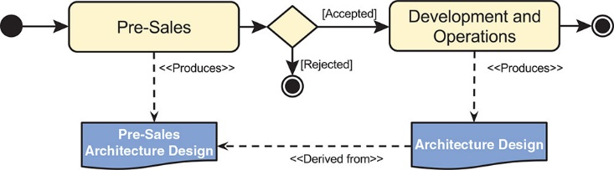
Project Development Phases
In nearly all projects there are 2 major development phases:
Pre-sales and
Development and operations

Slide 4
Project Development Phases
During the pre-sales phase, the scope of the project is established and a business case is established.
Output product: an estimation of the cost and duration of the project.
The development and operations phase occurs after the customer accepts the cost and duration of the project.
Development can be performed following different methodologies including Agile, RUP, or TSP.
Once the system (or part of it) is developed, it is put into operation.
DevOps intend to reduce the gap that is usually present between development and operation

Slide 5
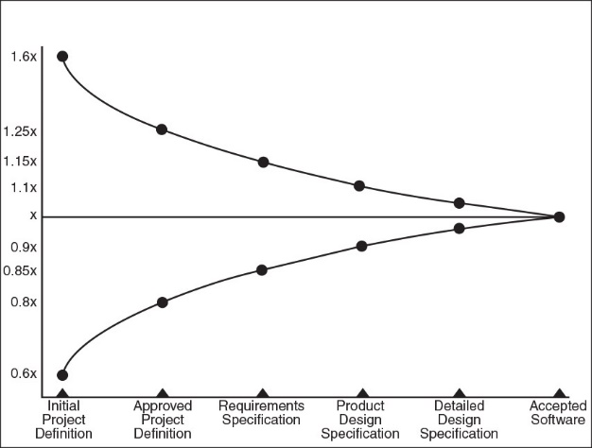
Architecture Design During Pre-Sales
In many software development projects the developer needs to estimate the cost and time of the product.
Typically only high-level requirements or features (rather than detailed use cases) are available at this phase.
Cone of Uncertainty
The goal is to narrow the cone of uncertainty earlier in the project’s life cycle

Slide 6
Architectural Practices to Reduce Cone of Uncertainty
Even if it may be complicated to describe detailed quality attribute scenarios at this point, the most important quality attributes with initial measures and constraints should be identified.
ADD can be used to produce an initial architecture that is then used as the basis for early cost and schedule estimates.
Sketches of this initial architecture are useful for communication with the customer. They are also useful as a basis to perform lightweight evaluations of this initial design.

Slide 7
Standard Components
Initial architecture allows estimation to be performed using the “standard components” technique.
historic databases that contain, for example, measurements and size data for components that have been built into previously developed systems.
need to identify the components that will be required for the problem that you are trying to solve, and then use historical data to estimate the size of these components.
The total size can then be translated into effort, and these estimates can be rolled up to produce a project-level time and cost estimate.

Slide 8
ADD in Pre-Sales
Similar to the steps used in “greenfield” systems.
Iteration 1 Goal:
Address the concern of establishing an initial overall structure for the application. Define standard components to be used for estimating the cost of the product.
Iteration 2 Goal:
Identify components to support all of the functionality that needs to be considered for the estimation.
In order to get a good estimate consider all of the important functional requirements and map them to the architecture.
Iteration 3 Goal:
Pick quality attributes that have significant impact on the cost
For example, include identifying redundant hardware or additional standard components to address quality attributes such as performance, availability, and security.
If the product is accepted then this architecture can be used as a preliminary design and ADD can be used for “brownfield” systems.

Slide 9
Architecture Design in Agile Process
Agile Manifesto
“Individuals and interactions over processes and tools, working software over comprehensive documentation, customer collaboration over contract negotiation, and responding to change over following a plan”.
The original creators of the Agile Manifesto described 12 principles behind the manifesto.
11 of these are in line with architectural design.
“The best architectures, requirements, and designs emerge from self-organizing teams” is not but this principle only applies to small and medium sized projects.

Slide 10
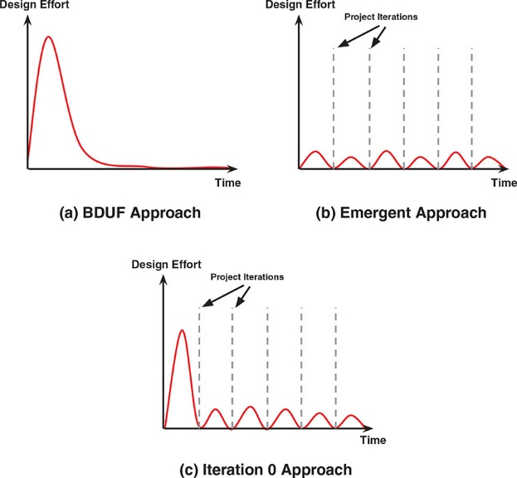
Architecture Design in Agile Process
Software architecture design is “up-front” work.
Emergent approach:
coding with minimal or no up-front analysis or design.
Big Design Up Front (BDUF):
collect all the requirements up front, and from that synthesize the ideal architecture.
The BDUF approach is not very popular as it can end up producing an extensively documented but untested design that may not be appropriate

Slide 11
Right Amount of Agility?
How much up-front work, in terms of requirements analysis, risk mitigation, and architecture, should a project do?
Hard to estimate
Perform a few ADD iterations.
Iteration 0 Goal:
Choose the major architectural patterns (including a reference architecture, if one is appropriate) and frameworks.
This will help to structure the project, define work assignments and team formation, and address the most critical quality attributes.
Agile architecture practices, help to tame some of the complexity, narrowing the cone of uncertainty and hence reducing project risk.
Agile spikes allow prototypes to be built quickly and to “fail fast”, thereby guiding the eventual selection of technologies

Slide 12
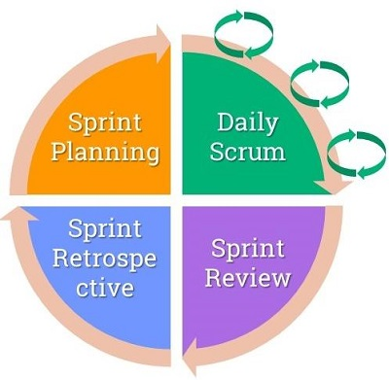
Typical Sprint in SCRUM
Sprit is expected to last 2-4 weeks.
Small windows of change in daily scrums
Strong focus on team collaboration
Roles:
Product owner
Scrum master
Development team
Reproduced from “Towards an Agile Software Architecture,” B. Mihaylov, https://www.infoq.com/articles/towards-agile-software-architecture

Slide 13

SCRUM Team Architect
Architect is part of the SCRUM development team.
Balances between the big picture and now
Hands-on experience
Produces prototypes to make informed decisions
Focus on sustainability

Slide 14
Agile Software Architecture
Maybe a “Sprint 0” iteration similar to “Iteration 0” idea.
development environment is configured and some fundamental decisions are made (for example programming language, platform, database, etc.).
Danger!!
In many cases you find yourself already working on the system, without even having the user stories, because “it will be really cool to have that helper feature implemented in advance”.
Software architecture is a constantly ongoing process in the agile approach so one should start with a partial architecture and keep refining it.
“Good architecture enables agility”

Slide 15
Agile Governing Principles
Keep it Simple, Stupid (KISS)
You Aren’t Gonna Need It (YAGNI)
Keep asking yourself is this artifact, decision, or feature required at this time?
Danger!!
When applying these two principles is that we tend to delay everything until the last possible moment. By then it may already have become too difficult to implement the required change.

Slide 16
Real-world Example
I was working on a project about selling ferry tickets on-line. It was a complex system as it required communication with 4 other 3rd-party systems. In the beginning we focused primarily on implementing features based on user stories. Although we knew we were going to need a sophisticated caching mechanism, we delayed it as it was not needed in that particular moment – we had to focus on the present user stories. At a later point, however, the system became slow due to the extensive communication with the other 3rd-party systems. We didn’t have any other choice but to stop the work on the user stories and focus on the caching mechanism – it was already difficult to implement it.
Reproduced from “Towards an Agile Software Architecture,” B. Mihaylov, https://www.infoq.com/articles/towards-agile-software-architecture

Slide 17
What to Document
Agile process minimizes the amount of documentation.
Document so you and the team have a common understanding about the system and the notations used.
What about UML Notation?
Even though it has not been highly adopted no other as widely adopted notation exists.
Diagraming tool are still popular, like Visio, for persistency and reproducibility.
The most important aspect of agile software architecture is not the designs, diagrams or documentation but the shared understanding of how the system should be built.

Slide 18
Class Exercise
Design Architecture based on Agile Principles
In the article “An Agile Approach to Software Architecture ” https://www.agileconnection.com/article/agile-approach-software-architecture they list some of the agile manifestos and discuss how architecture design conforms to those manifestos.
Read this article and highlight how architecture design needs to change to adapt to being agile.

Slide 19
Architecture Design in RUP
The Rational Unified Process (RUP) is a software development process framework that puts a strong emphasis on architecture.
Inception: scope of the project and a business architecture are defined and a candidate architecture is established (similar to pre-sales). ADD iterations can be performed to establish the candidate architecture.
Elaboration: ADD can be used to baseline the architecture and produce architectural prototypes.
Construction: ADD iterations can be used to incrementally develop the system from the architecture
Transition: transitioned from the development environment to its final operation.

Slide 20
Architecture Design in TSP
The Team Software Process (TSP) is a development process that strongly emphasizes quality and measurement.
A series of development cycles, where each cycle begins with a planning process called a launch and ends with a closing process called a postmortem.
Within each development cycle, activities belonging to different phases can be performed.
Requirements (REQ),
High-level design (HLD),
Implementation (IMPL), and
Testing (TEST).

Slide 21
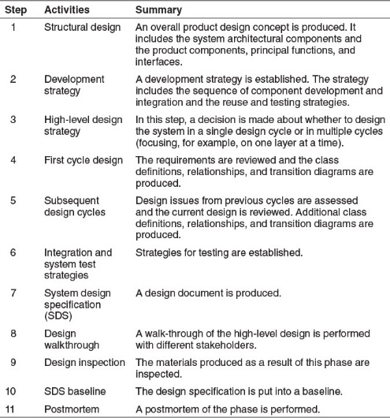
Architecture Design in the TSP
The TSP does not give full consideration to software architecture development.

Slide 22
ADD in the TSP
TSP step 1:
ADD can be used to produce the overall product design concept, similar to what was discussed for the pre-sales process.
TSP steps 4&5
One or more ADD iterations can be performed
A TSP development cycle can involve a few ADD iterations followed by the element interaction design activities that include identification of elements and their interfaces.
These interfaces are later used in the development phase (IMPL) for performing detailed design and development of the elements.

Slide 23
Architecture Design in DevOps
DevOps is a natural outgrowth of the Agile mindset and intentionally blurs the distinction between “development” and “operations”.
DevOps refers to a set of practices that help achieve continuous delivery of software.
Small iterations are supported and encouraged, creating an environment where Agile spikes are easy to create, deploy, and test, thereby providing crucial feedback to the architect.
Architects should embrace the DevOps process so that critical activities such as continuous build integration, automated test execution, high availability, and scalable performance can be incorporated.

Slide 24
ADD and DevOps
Adopting the DevOps approach requires a small change in the mindset of an architect.
Instead of just designing the system, you now need to think about the design of the entire deployment pipeline.
ADD can help design a system to achieve DevOps goals,
The design concepts that help us to achieve modifiability or testability or scalability or high availability in a system can also be applied to the deployment pipeline.
Having said that no concrete example is presented.

Slide 25
Other aspects that affect Architectural Design

Slide 26
Designing as an Individual or as a Team
In large and complex projects, it seems straightforward that an architecture team should be responsible for performing the design.
No matter the size of the team the recommendation is to appoint a lead architect.
There ae many advantages to team development but let’s talk about the concerns:
Design by committee can be complicated
The cost and time for development increases
Managing the logistics can be complicated
You may encounter personality and political conflicts.

Slide 27
Design Concepts Catalog
Most design drivers have most certainly been addressed in other systems previously.
The selection of design concepts is one of the most challenging aspects of the design process.
This problem is exacerbated by the fact that information is scattered in many places:
Architects usually need to consult several pattern and tactics catalogs and do extensive research to find the design concepts that can be considered and used.
A design concepts catalog is a good idea in a company.
Such a catalog is available in Appendix A in Cervantes book.

